Slide 1

POWER CONSUMPTION PREDICTION USING ML

Slide 2

MEET THE PRESENTER
MANU C MADHU
linktr.ee/manucmadhu

Slide 3
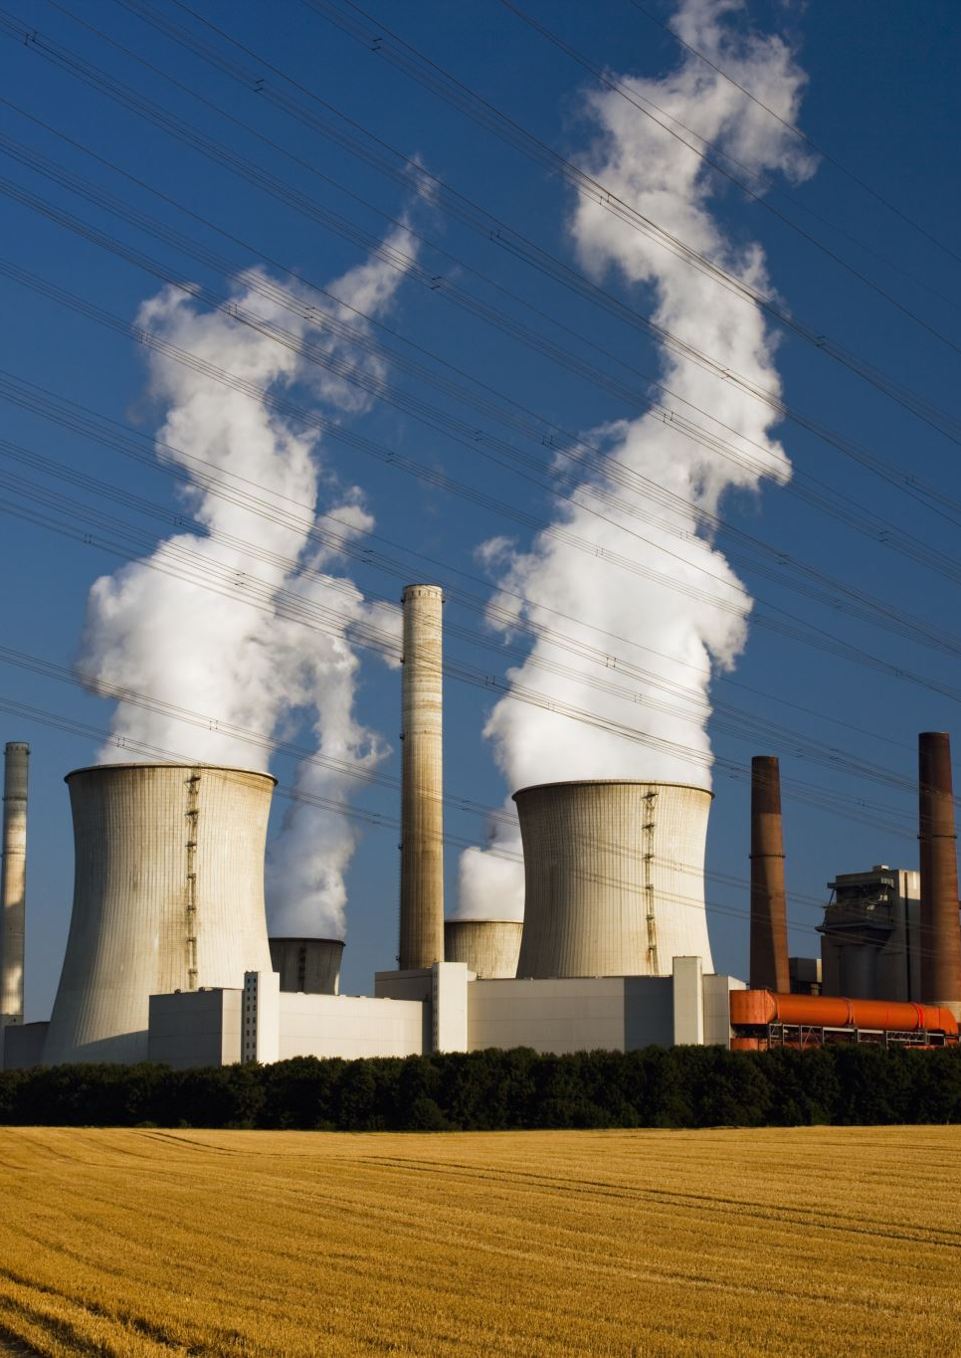
Introduction
Power Consumption is increasing day by day and its being crucial to manage power
It is advised to manage power efficiently as most of the power sources are non-renewable
Effective power management can be done by only generating the required power it can be done by predicting the usage early with the help of existing data

Slide 4

Abstract
Accurate energy consumption prediction is essential for efficient power system management and integrating renewable energy. This study uses Machine Learning (ML) techniques like Linear Regression, Decision Trees, Random Forests, and Artificial Neural Networks (ANN) to forecast energy usage. Analyzing historical data and factors like weather, our models show superior accuracy over traditional methods, with ANN and Random Forests performing best. The results support improved energy management and grid optimization. Future work will focus on integrating real-time data and advanced ML methods to further enhance prediction accuracy.

Slide 5

Identified Problem Global Power Outage
Many power grids around the world are outdated and lack resilience. This makes them vulnerable to cyber-attacks, physical attacks, and natural disasters, leading to widespread and prolonged outages.
Severe due to factors like aging infrastructure, rising electricity demand, and extreme weather events exacerbated by climate change.
Causes significant economic losses, affecting businesses, disrupting industrial operations, and leading to financial losses. outages can cost billions
Can compromise public safety and health by disrupting essential services such as hospitals, emergency response systems, and water supply
Variability in renewable energy production can lead to imbalances in supply and demand, increasing the risk of outages if not properly managed.

Slide 6
Solution Power Consumption Prediction

